Slide 1
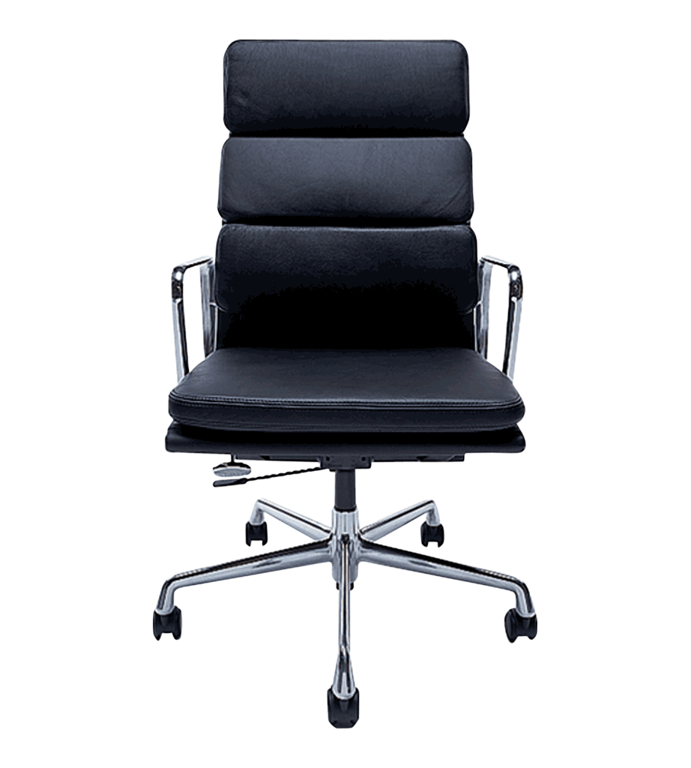
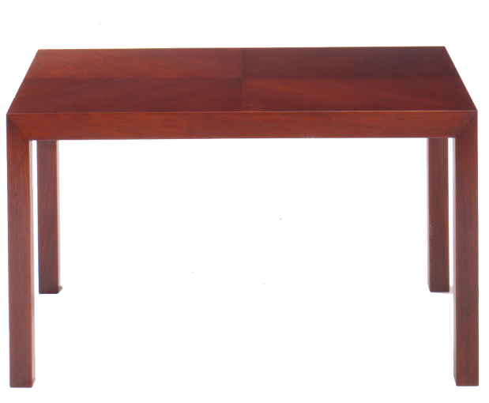
Welcome to my class!
Mrs. Presley
5th Grade
Room 209

Slide 2
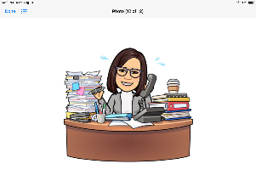
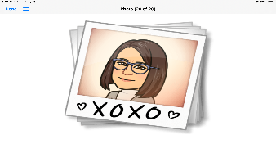
Meet Mrs.Presley
I am excited to start my 19th year at Buder Elementary! I have taught grades 2nd – 5th while at Buder. For the past few years, I have been departmentalized, mainly teaching math. This year, I am exciting to be teaching all of the subjects. I am happily married to my husband, Ferman, and I have three awesome boys, Austin (22), Logan (20), and Bryson (16). I enjoy spending time with my family, watching TV, playing games on my phone, and learning something new everyday. I am looking forward to getting to know you and working with you both virtually and in person. Parents, I welcome and appreciate your involvement. Please feel free to email me (Sheri.Presley@slps.org) or call me (314-352-4343) when you have a question, comment or concern. I can also be reached on Teams or Class Dojo. The more closely we work together, the better we can help your child reach his/her full potential in 5th grade and be prepared to move on to middle school.
Let’s have an awesome school year together!
Superheroes: Show Your Superpowers!

Slide 3
School Supplies
# 2 Pencils
Eraser
Crayons
Colored Pencils
Markers
Scissors
Glue Stick
Pencil Sharpener
Lined Paper
4 Spiral Notebooks
Ear Buds or Headphones
Folders for important papers
(optional) Pencil Pouch

Slide 4
Our Class Schedule
TIME | ACTIVITY | SUBJECT
8:15 – 9:05 | Related Arts | Music, PE, Art
9:10 – 9:25 | Class Meeting | Whole Group
9:25 – 9:45 | ELA | Whole Group
9:45 – 10:20 | GROUP A | Reading Math
10:20 – 10:55 | GROUP B | Reading Math
11:00 – 11:20 | Writing | Whole Group
11:20 – 11:55 | GROUP C | Reading Math
11:55 – 12:30 | GROUP D | Reading Math
12:30 – 1:00 | Lunch
1:00 – 1:30 | Math | Whole Group
1:30 – 2:00 | Science Social Studies | Whole Group
2:00 – 3:12 | Asynchronous Support | All Subjects

Slide 5
Be Prepared!
Be Respectful!
Be Appropriate!
Join us on time,
dressed, and
sitting tall!
Have your
learning tools ready!
Listen to the speaker. Be respectful
of others
in the meeting!
Use the chat
for questions
and comments
only.
Don’t type silly
comments.
.
Be a Scholar!
Be in control!
Be patient!
Focus on the
teacher.
Participate
during the lesson.
Try your best!
Show control of your body while on video.
Be calm! If
you need to
ask for help,
raise your hand!
We are all learning
how to do online
school! Be patient
with others as
we learn together.

Slide 6
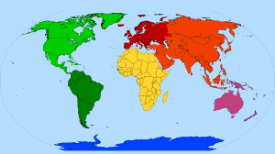
Click on a computer screen to be taken to the website…
NEAR
POD
SAVVAS
TEAMS
MYSTERY
SCIENCE

